Slide 1
Why Russia doesn‘t get forward

Slide 2
Quick overview
Started in February 2014
Real Invasion stared on the February 24th, 2022
Killed:
around 10.000
2.000 Civilians
Injured:
around 22.800
Total Military Personal:
Russia: 1.350.000
Ukraine: 500.000
Notes:
2014 Invasion der Krim

Slide 3
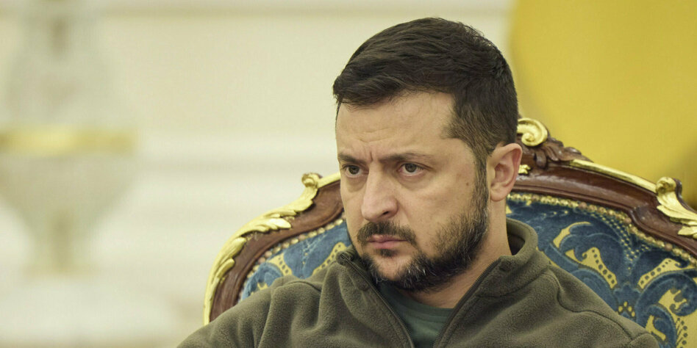
Why did this war start?
Invasion of the Crimea
Pro russian president was replaced by a pro western president
Donezk and Luhansk declared their independence
Ukraine wanted to join the North Atlantic Treaty Organization(NATO) and the EU

Slide 4
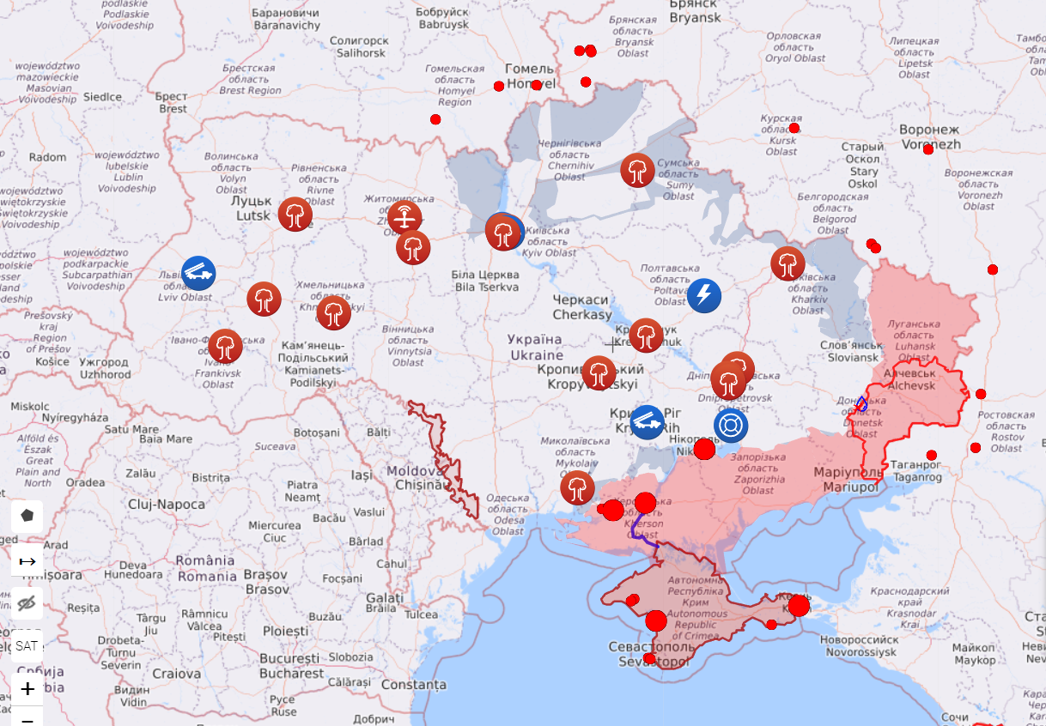
Liveuamap.com

Slide 5
So, why doesn‘t they get forward?
Bigger range with western weapons
Western weapons more accurate than the ruassian weapons
Anti-tank weapons
More people want to defend their country
Nearly no support for that war in Russia
No Russian AirForce
Russian Army use old Soviet strategies
Newer Tanks are too expensive for the Russians
Notes:
Bigger range 80 km with western Weapons
Anti-tank weapons soviet strategie sending many tanks and Ukraine get from west
Startegies sending tanks
New T-14 tank cost 7.1 Million sanctions for technology only 20 instead of 2.300 Tanks T-72 1.2 Million

Slide 6
What can happen in the Future?
Nuclear-Bomb
Ukraine defeats Russia
Revolution in Russia?
Ukraine loses all the territories that are Russian now and sign peace
Ukraine get completely annexed

Slide 7
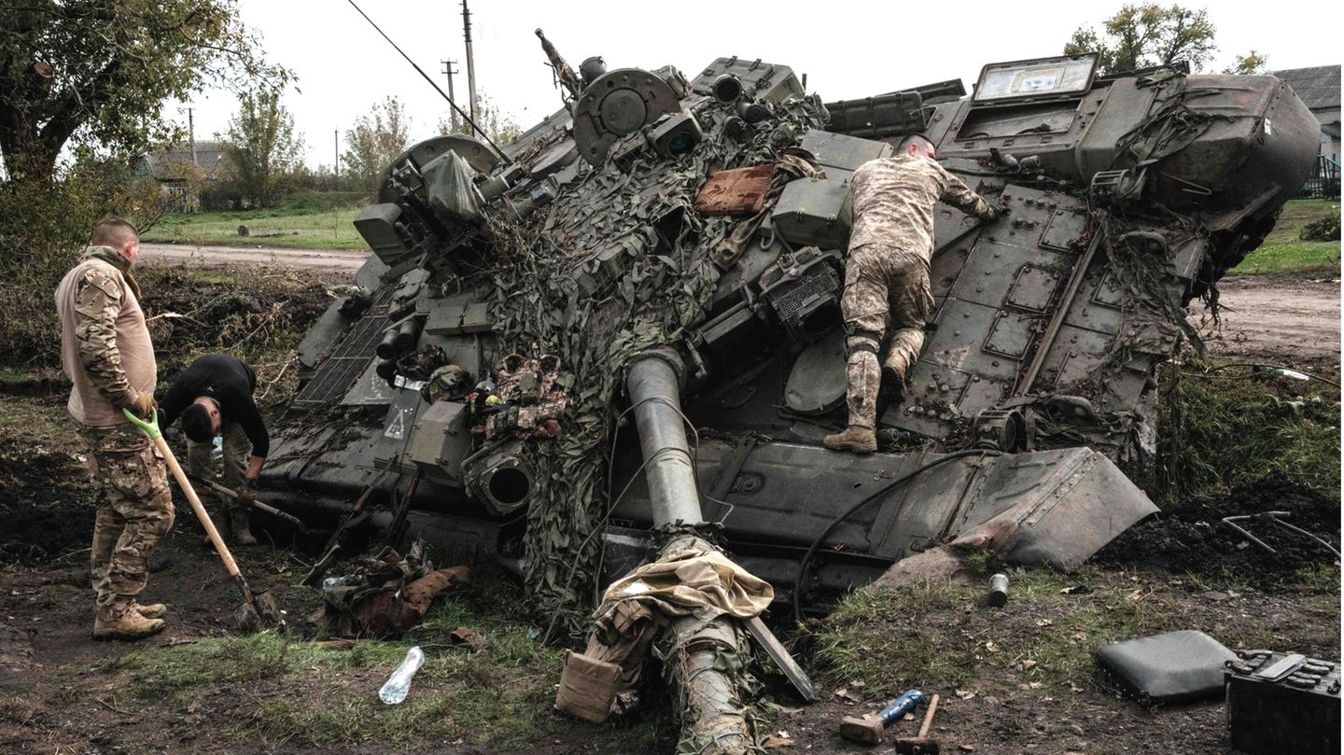
Tanks for listening!

